Slide 1


Store Item Data Demand Forecasting
By
Harsha Maddipati
Nikhil Chakravarthy Doppalapudi
Notes:
Harsha: Hello, everyone, The main goal of our project is to predict the Store item demand, in various seasons, months, and days of the week. We predicted 3 months of sales for 50 different items at 10 different stores. We are given 5 years of data, from 2013 to 2018 where we take the data in the year 2018 for testing purposes.
We had to explore different methods on how to deal with seasonal purchases of items throughout the year. For example, Sales of jackets and sweaters increase during the months of November, December and January. We accommodate these seasonal sales by considering the data as a time series. We then, analyzed yearly, monthly and Weekly sales trends to get a visual understanding.

Slide 2
What is it about?
The main goal of our project is to predict the Store item demand
We predicted 3 months of sales for 50 different items at 10 different stores.

Slide 3
What is it about?
The main goal of our project is to predict the Store item demand
We predicted 3 months of sales for 50 different items at 10 different stores.

Slide 4
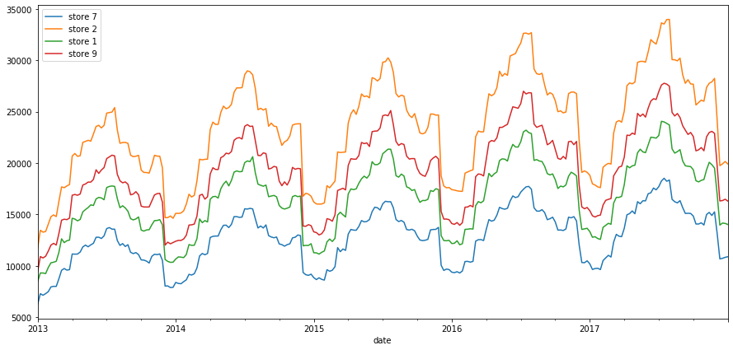
Yearly Trends
Notes:
These are the sales of all the items in stores 1, 2 ,7 and 9 from the years 2013 to 2017.
We notice 3 things here:
- All these stores have very similar sales trends. This could be because the data is generated by kaggle without taking other features like population, and location into consideration.
-For the same store we see similar trends across all the years.
-Even though trends are similar for all stores, store 2 seems to have a higher number of sales than others, which suggest that it is a bigger store or the items sold are cheaper in price compared to the rest.

Slide 5
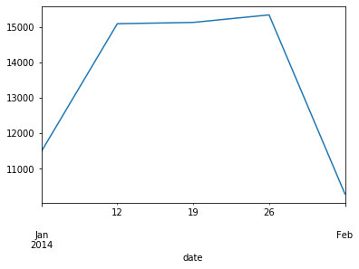
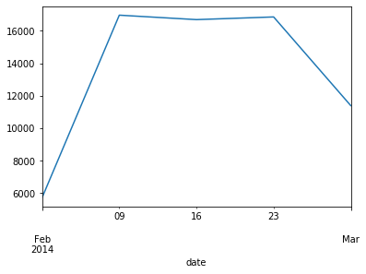
Monthly Trends
January
February
Notes:
We can get a better understanding if we look at the monthly sales of items. As the trends are similar for all stores, we are going to take Store 2 as a base for
As we can see sales trends are low at the start of the months and increases gradually. Constant in the middle and decreases at the end of the month. This is not the case for all months

Slide 6
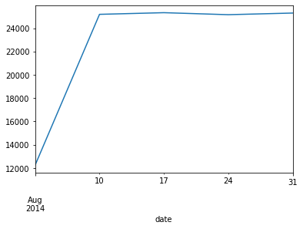
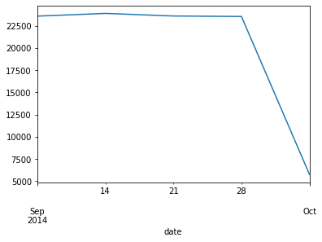
Monthly Trends
August
September
Notes:
In Aug | Sept the sales are very high end of Aug and the start of Sept. This could be due to the fall season sales or start of scademic year.

Slide 7
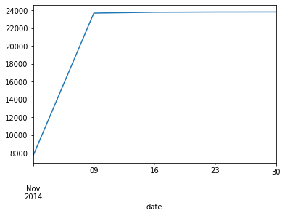
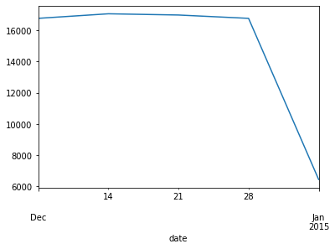
Monthly Trends
November
December
Notes:
In Nov | Dec we see a similar trend, This could be due to winter sales or due to holiday sale.

Slide 8
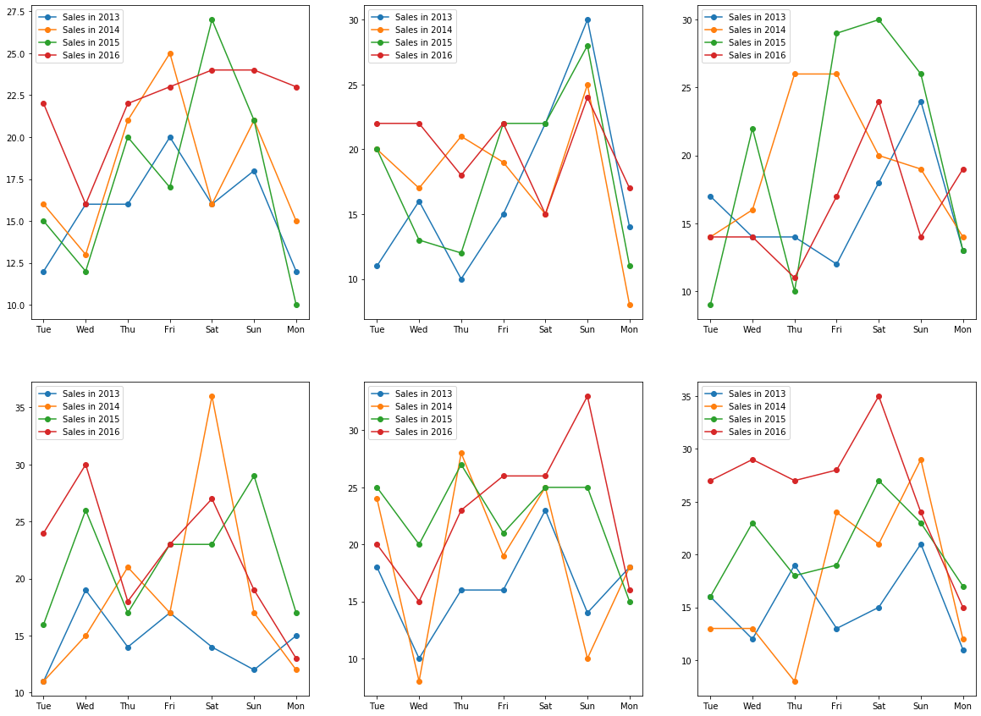
Weekly Trends
Notes:
Here we see that most of the sales occur as the week comes to an end i.e on Friday, Saturday and Sunday. From Sunday to Monday the Sales drastically decrease as seen on the plots.

Slide 9
Add features
New features
Day of year
Day of quarter
Quarter
Day of week
Month
Average of Item, Store and Day of the Year
Average of Item Store and Day of the week
Average of Item, Store and Day of the Month
Notes:
To incorporate these trends in our prediction by creating additional features by taking averages of the
item, store and day of the year values.
Item, store and day of the week values.
Item, store and day of the month values.

Slide 10
Prediction Algorithm
Gradient Descent
XGBoost
Extreme Gradient Boosting

Slide 11
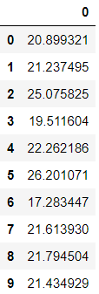
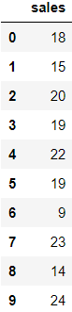
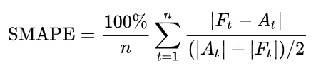
Accuracy Measure
Symmetric mean absolute percentage error
(SMAPE)
Forecasted
Actual
SMAPE is an accuracy measure based on percentage error. Given by the Formula:
We obtained an error rate of 13.6%

Slide 12
Thank you

